Slide 1

Computer Networks
Chapter 1 – Introduction to Computer Networks

Slide 2
What can you expect from this class?
Knowledge about how computer networks work
Knowledge about the function of the Internet
Understanding the network terminologies
Different communication methods and how they are used
Understanding how data delivery works
Network protocols and models

Slide 3
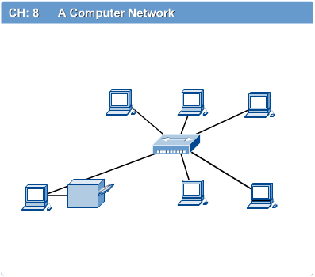
What is a computer network ??
A computer network connects two or more computers linked together
The computers can be in same location or far away from each other

Slide 4
Applications of networks
Resource Sharing Hardware (computing resources, disks, printers) Software (Application software)
Information Sharing Easy accessibility from anywhere (files, database, FTP) Search capability (WWW)
Communication Email Messaging
Remote Computing
Distributed processing (GRID computing)

Slide 5
Some networking words and their definitions
Packets – The smallest unit of data sent from one computing device to another on a network
Frames – Slightly larger than a packet, frames contain the packet plus the addressing and the necessary protocol information.
Protocol – A set of rules and standards that define how two devices communicate. There are several protocols used for different types of networks.

Slide 6
Types of networks based on location
A network in a small geographical area such as a room, building or campus is called as Local Area Network (LAN)
A network in a city is called as Metropolitan Area Network (MAN)
A network spread geographically is called as Wide Area Network (WAN)

Slide 7
Building Blocks of a network
Hardware (network interface card)
Applications
Transmission media
Interconnecting devices
Workstations
Protocols

Slide 8
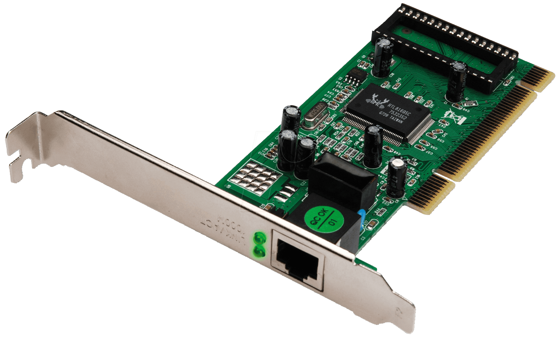
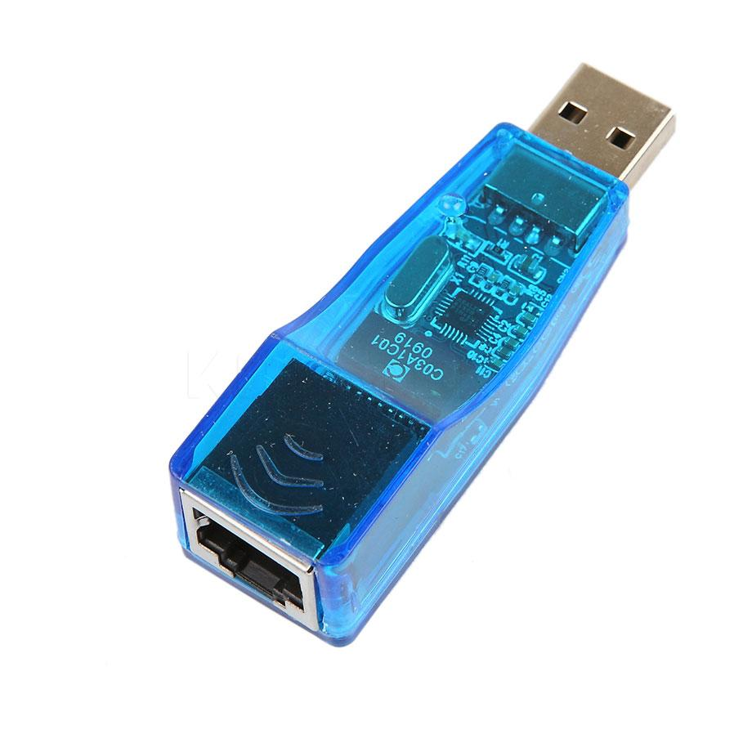
Network Interface card
A network interface card (NIC) is a circuit board or a card that is installed on a computer so that it can be connected to a network

Slide 9
Applications
E-mail
Searchable Data (Web Sites)
E-Commerce
News Groups
Internet Telephony (VoIP)
Video Conferencing
Chat Groups
Instant Messengers
Internet Radio

Slide 10
Transmission media
The method of transmitting data from source to destination
Can use copper cable or wireless or fiber optic

Slide 11
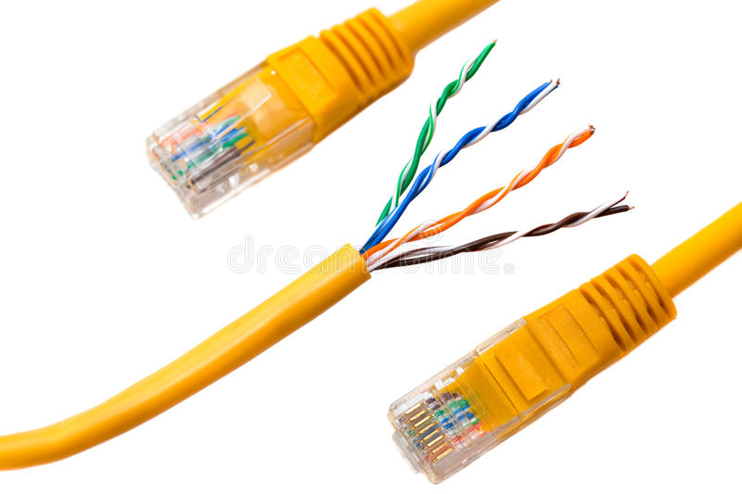
Transmission Media (Twisted pair)

Slide 12
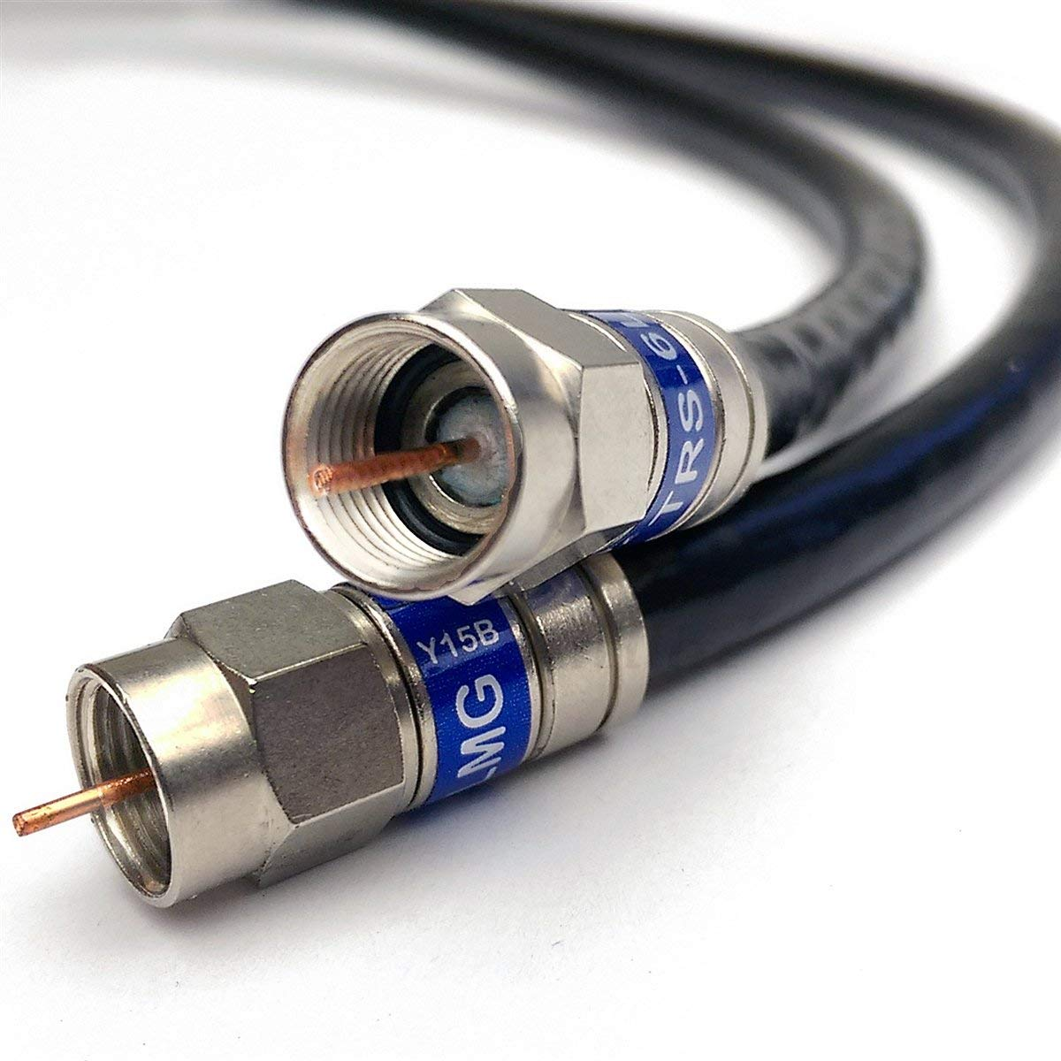
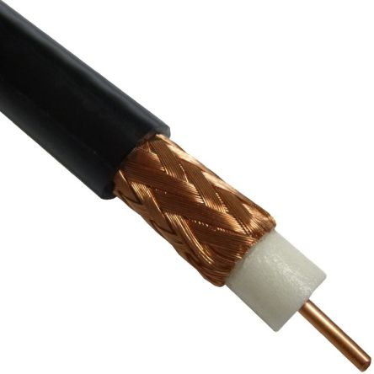
Transmission Media (Coaxial cable)

Slide 13
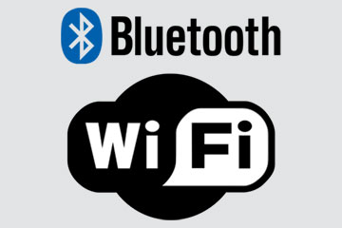
Transmission Media (Radio frequency)
Bluetooth technology uses short range radio frequency to transmit data
WIFI technology uses a different radio frequency which have a longer range

Slide 14
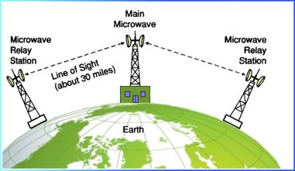
Transmission Media (Microwaves)
Mostly located on top of buildings, towers or mountains to avoid any obstruction.

Slide 15
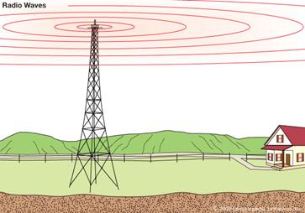
Transmission Media (Radio waves)
Radio waves are used for cell phone signals and for AM and FM radio transmission

Slide 16
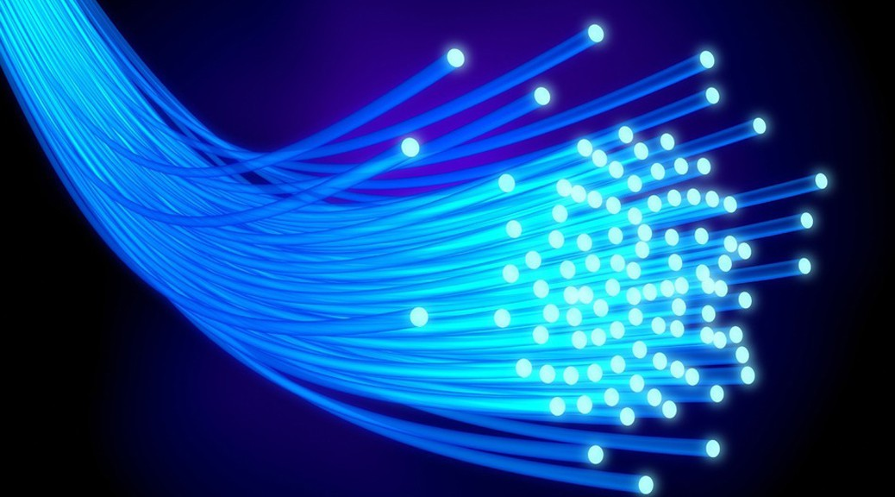
Transmission Media (Fiber Optic Cable)
Doesn’t use electricity or radio or microwaves for transmission but light

Slide 17
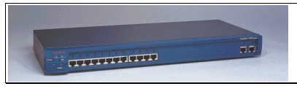
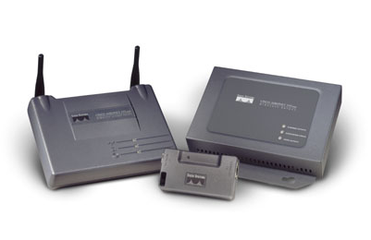
Networking devices
Hub, switches, routers, wireless access points, modems, bridges

Slide 18



What’s a protocol?
a human protocol and a computer network protocol:
Hi
TCP connection
request
Hi
TCP connection
response
Got the
time?
Get http://www.awl.com/kurose-ross
2:00
<file>
time

Slide 19
Networking protocols
Network communication: TCP/IP and HTTP
Network security: HTTPS, SSL, SFTP
Network Management Protocol: SNMP, ICMP

Slide 20
Nodes
A node is any network device that can connect to the network and can generate, process or transfer network data. Every node is has at least one unique network address

Slide 21
Network Topologies
A network topology defines the ways in which computers, printers, and other devices are connected.
A network topology describes the layout of the wire and devices as well as the paths used by data transmission.

Slide 22
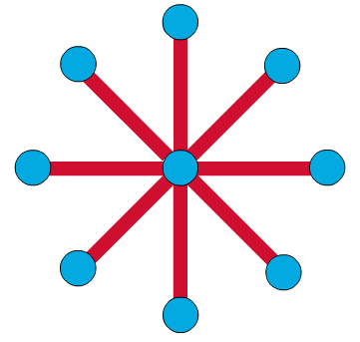
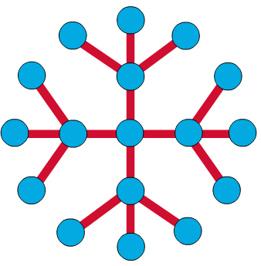
Star Topology
The star topology is the most commonly used architecture in Ethernet LAN’s
Larger networks use the extended star topology also called tree topology. When used with network devices that filter frames or packets, like bridges, switches, and routers, this topology reduces traffic on the wires by sending packets only to the wires of the destination host

Slide 23
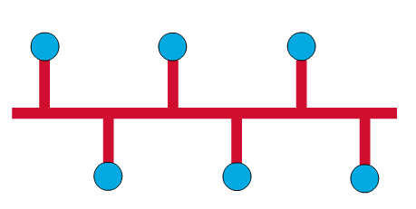
Bus topology
Commonly referred to as a linear bus, all devices on a bus topology are connected by one single cable (bus)

Slide 24
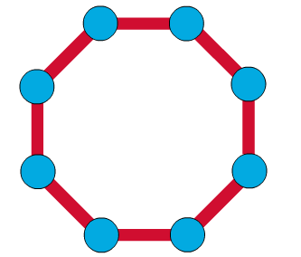
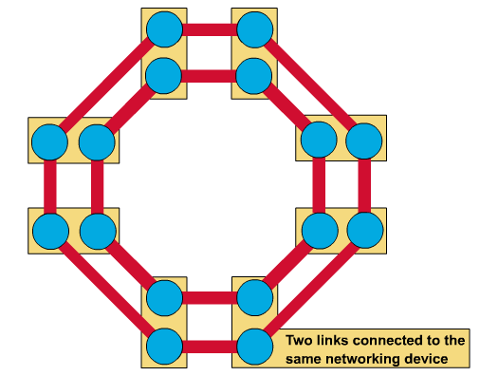
Ring topology
A frame travels around the ring, stopping at each node. If a node wants to transmit data, it adds the data as well as the destination address to the frame.
The frame then continues around the ring until it finds the destination node, which takes the data out of the frame.
Single ring – All the devices on the network share a single cable. Dual ring – The dual ring topology allows the data to be sent in both directions.

Slide 25
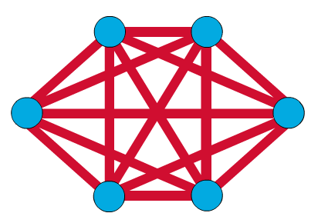
Mesh Topology
The mesh topology connects all devices (nodes) to each other for redundancy and fault tolerance.
It is used in WANs to interconnect LANs and for mission critical networks like those used by banks and financial institutions.
Implementing the mesh topology is expensive and difficult.

Slide 26
Types of network architecture
Let us look at some more definitions first
Client – A client is a network computer that utilizes the resources of other network computer. The client computer has it own processor, memory and storage, and can maintain some of it own resources and perform its own task and processing.
Server – A server is a network computer that shares resources and responds to request from other network computers. Server provides centralized access and storage for resources that can include applications, files, printers or other hardware and specialized services such as email.
Peer – A peer is a self sufficient computer that acts as both a server and a client to other similar computers on the network.

Slide 27
Client – Server network
It is widely used and forms the basis of much network usage. It is applicable when the client and server are both in the same building (e.g., belong to the same company), but also when they are far apart.
Communication takes the form of the client process sending a message over the network to the server process. The client process then waits for a reply message. When the server process gets the request, it performs the requested work or looks up the requested data and sends back a reply.

Slide 28
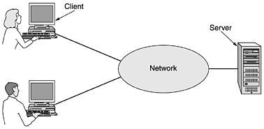
Client – server architecture

Slide 29
Peer-to-peer network (P2P network)
P2P networking was made popular with an audio sharing service called Napster (closed by courts in 2001 because of copyright issues with music sharing).
Peer-to-peer systems eliminates the central database by having each user maintain his own database locally, as well as providing a list of other nearby people who are members of the system.
They are decentralized, easy to implement and inexpensive.

Slide 30
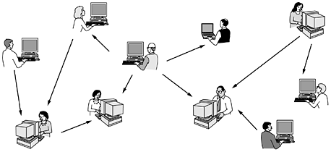
Peer-to-peer network (P2P network)

Slide 31
IP Address
Internet Protocol Address
A logical numerical address that is assigned to every single node (computer, printer, phone, switch, router or any other device) that is a part of a TCP/IP network
Consists of two parts – network ID and host ID
IP address are of two types – IPv4 and IPv6

Slide 32
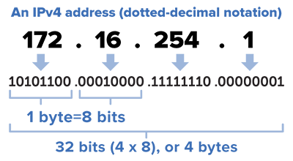
IPv4 Address
IPv4 Addresses are in 32 bit form

Slide 33
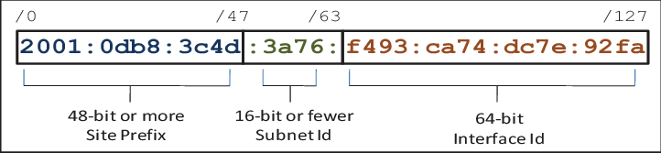
IPv6 Address
IPv6 addresses are in 128 bit form

Slide 34
MAC Address
Media Access Control Address
Hardware address unique to the network card on the computing device
MAC addresses are burned into the network card’s ROM by the manufacturer

Slide 35
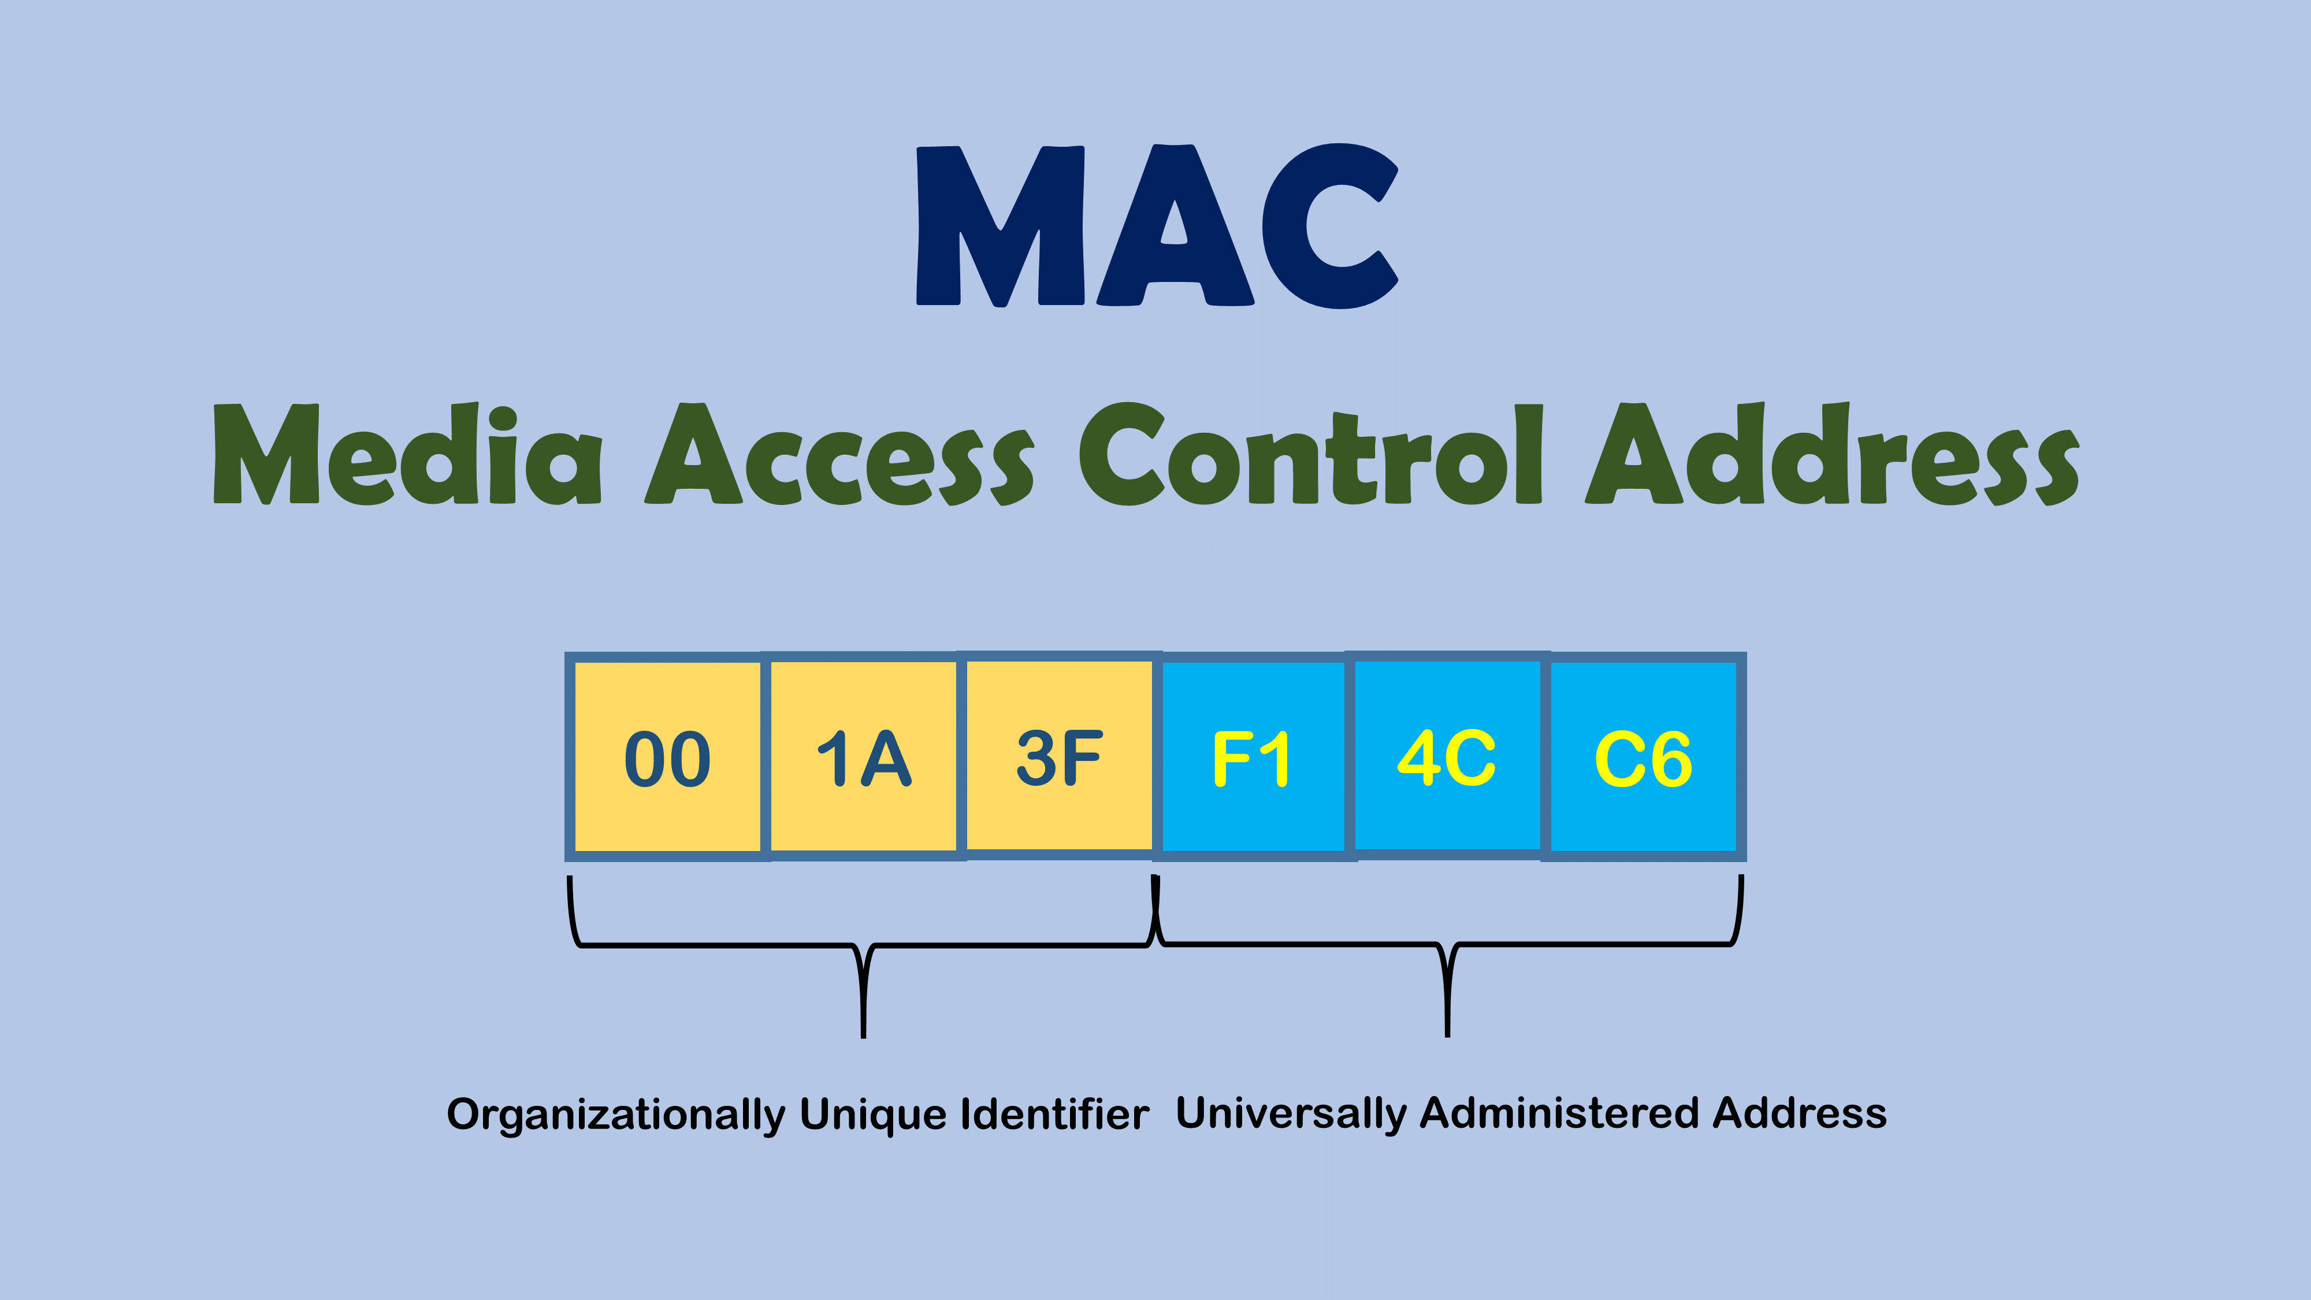
MAC Address

Slide 36
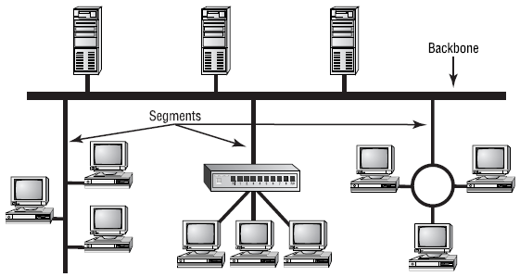
Network backbone
The network backbone is the highest speed transmission path that carries the majority of network data. It can connect small networks together into larger structure, or connect server nodes to the network where the majority of the clients computers are attached.

Slide 37
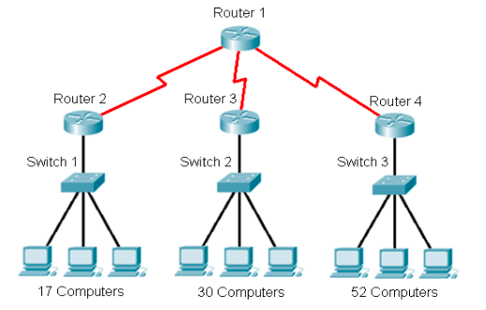
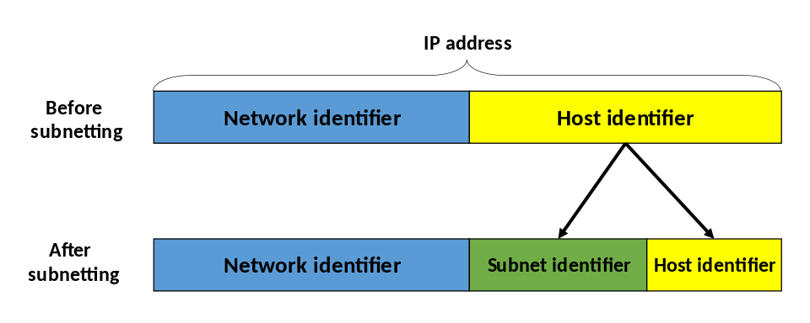
Subnets
A subnet is a portion of a network that shares a common network address. The subnet can be on a separate physical network segment, or it can share segments with other logical subnets.
In simple words – a logical division of an IP network

Slide 38
Data Communication
The term telecommunication means communication at a distance. The word data refers to information presented in whatever form is agreed upon by the parties creating and using the data.
Data communications are the exchange of data between two devices via some form of transmission media

Slide 39
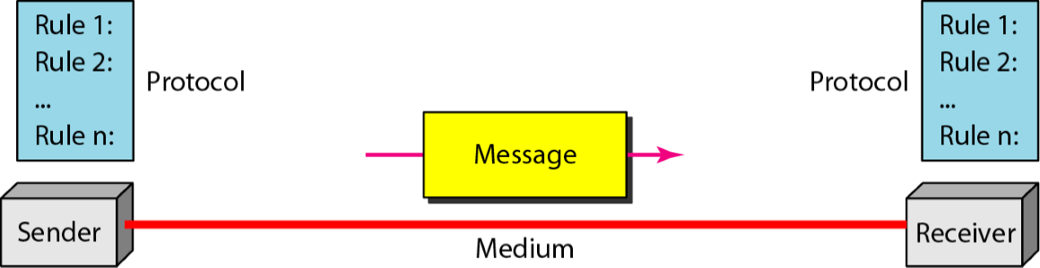
Data communication system

Slide 40
Modes of communication
Point to point →Dedicated →Shared (multiplexing)
Broadcasting →Dedicated (channel level one way) →Shared (Multiple access)
Multicasting

Slide 41
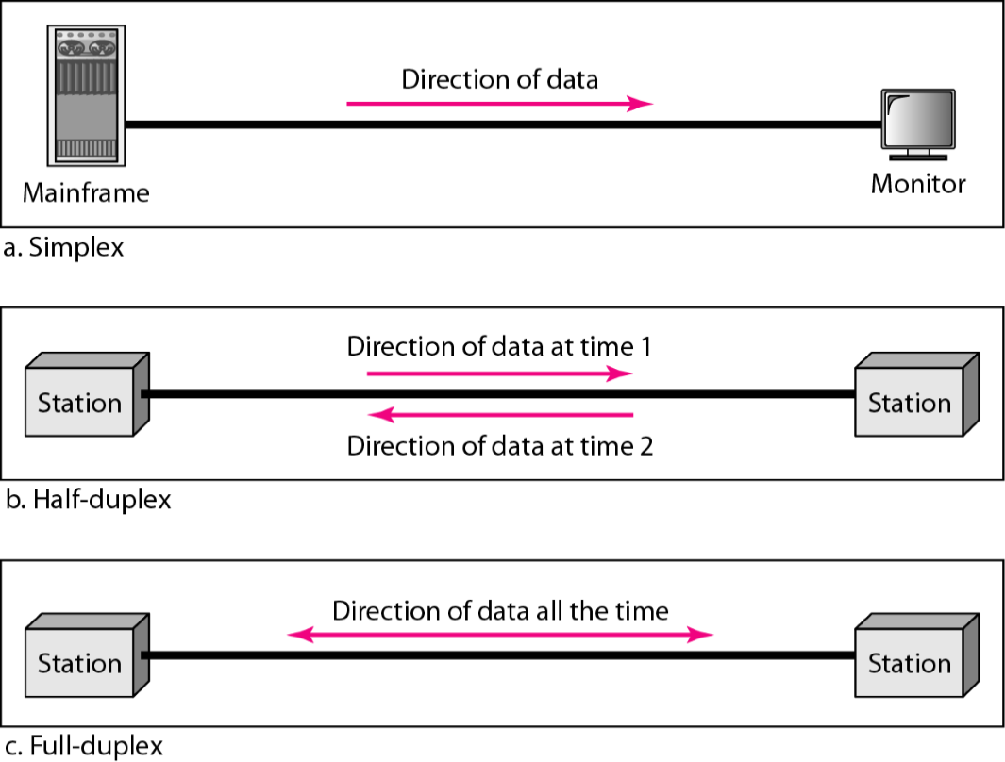
Data flow (simplex, half-duplex and full-duplex)

Slide 42
End of Chapter 1
Please check the Google Classroom page for any updates.
If you find anything that is interesting and/or related to the chapter, share it with everyone.
To read more on IP Addresses and subnets - http://www.steves-internet-guide.com/subnetting-subnet-masks-explained/

